Slide 1
Flocking behavior based on Opinion Dynamics: Hegselmann and Krause Model
By: Manas Tripathi
Under the Supervision of: Dr. Muneendra Ojha
AIMS Lab, IIIT- Allahabad

Slide 2
Index
Introduction
Flocking Behavior
Flocking Rules
Hegselmann and Krause Model
Problem Statement
Implementation
Results
Conclusion
References

Slide 3
Introduction
Opinion dynamics is a field of study that deals with how opinions and beliefs evolve and spread among individuals or agents in a social network or system.
It explores the mechanisms and rules governing how individuals influence each other and how their opinions change over time based on interactions and exchanges of information.
Opinion dynamics models are often used to understand collective decision-making processes, social influence, and consensus formation in various contexts, such as in social networks, political systems, cultural phenomena, and more.

Slide 4
Flocking Behavior
Flocking is a mesmerizing form of collective behavior exhibited by various natural and artificial systems, such as birds, fish, insects, and even autonomous drones.
In a flock, large numbers of agents interact with one another, resulting in cohesive and coordinated group movement.
This emergent behavior arises from simple local interactions between individual agents, without any centralized control or leader.
Key Characteristics of Flocking:
Self-Organization
Adaptability
Robustness
Decentralization

Slide 5
Flocking Rules
Flock Centering: Each agent attempts to stay close to its nearby flockmates, creating a sense of cohesion within the group.
Collision Avoidance: Agents actively avoid collisions with other flockmates, ensuring that the flock maintains its shape and structure.
Velocity Matching: Agents try to match their velocity with that of their nearby flockmates, resulting in collective motion and coordination.

Slide 6
Hegselmann and Krause Model
The Hegselmann and Krause model is a computational framework used to study opinion dynamics in social systems.
It provides valuable insights into how opinions evolve and converge among a group of interacting agents.
The model is particularly useful for understanding collective decision-making processes and the formation of consensus in society.
Basic Assumptions:
Interacting Agents: The model considers a population of agents, each holding an individual opinion on a specific topic.
Limited Communication: Agents can interact and influence each other's opinions, but their range of influence is limited to a certain threshold called "bounded confidence."
Opinion Update: At each time step, agents update their opinions based on the opinions of their neighbors within the bounded confidence range.

Slide 7
Problem Statement
Opinion dynamics and flocking behavior are two fascinating phenomena observed in social systems and collective movements.
The problem we aim to address is to understand the interplay between these two processes within a social system.
We seek to explore how the principles of flocking, such as flock centering, collision avoidance, and velocity matching, influence the process of opinion formation and convergence among a group of interacting agents.

Slide 8
Implementation
To study the interplay between flocking behavior and opinion dynamics, we have developed a simulation that incorporates the Hegselmann and Krause model along with flocking-inspired rules.
The simulation creates a virtual environment using pygame library in python, where agents interact, influence each other's opinions, and exhibit collective movement patterns. The simulation contains following rules:-

Slide 9
Opinion Update
At each time step, agents update their opinions based on the opinions of their neighbours within the bounded confidence range. The update is performed by taking the average of the opinions within this range.
User Interaction
We enable user interaction in the simulation by capturing mouse motion events. The position of the mouse cursor determines the target position that agents move towards. Users can influence the motion and behavior of the agents during the simulation.
Agent Initialization
Number of Agents (N): We start by initializing a population of N agents with random initial opinions.
Bounded Confidence: Agents will only interact and influence each other if their opinion difference is within this threshold.
Flocking Behavior
Flock Centering
Velocity Matching
Collision Avoidance
Separation

Slide 10
Results
The results highlight the emergence of collective patterns and the convergence of opinions among agents. The following observations were made during the simulation:
Flocking Behaviour:- The agents exhibited flocking behavior, characterized by alignment, cohesion, and separation. They demonstrated the tendency to move towards the center of the flock, align their velocities with neighboring agents, and maintain a minimum separation distance.
Opinion Convergence:- As agents interacted with their neighbors, their opinions gradually converged. Agents with similar opinions influenced each other, leading to opinion homogenization within the flock.

Slide 11
Impact of parameters:- The simulation results showed that adjusting the parameters of the model had a significant impact on the dynamics of the system:
Bounded Confidence:- A lower threshold resulted in faster convergence, while a higher threshold allowed for more diverse opinions within the flock.
Flocking Factors:- The factors controlling flock centering, velocity matching, collision avoidance, and separation influenced the cohesion and movement of agents. Adjusting these factors led to variations in flock structure and collective motion patterns.
Collision Avoidance:- Increasing the strength of Collision avoidance led to a reduction in agent collisions with neighbors.

Slide 12
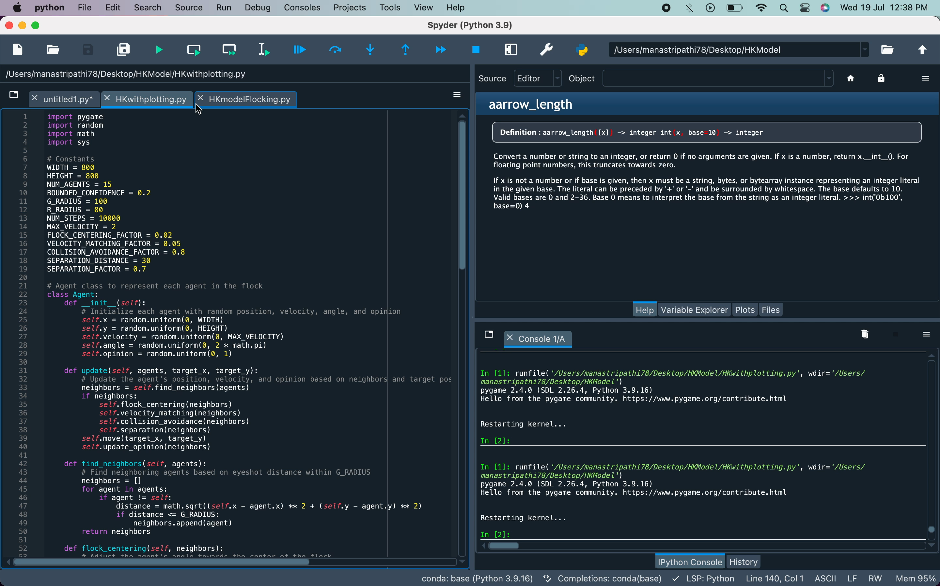
Output

Slide 13
Conclusion
Through the simulation, we observed that agents tended to align their opinions when they had similar viewpoints within a bounded confidence threshold.
The model also demonstrated the importance of social interactions, as agents adjusted their velocities and angles based on the behavior of their neighbors.
The simulation results highlighted the complex dynamics of opinion formation and the interplay between individual behavior and collective outcomes.
The model provided insights into consensus formation, polarization, and the impact of social influence on opinion dynamics.

Slide 14
References
Hegselmann, R., & Krause, U. (2002). Opinion dynamics and bounded confidence models, analysis, and simulation. Journal of Artificial Societies and Social Simulation, 5(3), 2.
Shusong LI, & Shiyong ZHANG (2010). The Opinion Dynamics and Bounded Confidence Model on Flocking Movement World, 355-358
Reynolds, C. W. (1987). Flocks, herds, and schools: A distributed behavioral model. ACM SIGGRAPH Computer Graphics, 21(4), 25-34.
R. Olfati-Saber, “Flocking for multi-agent dynamic systems: algorithms and theory”, IEEE Trans. Automat. Contr, vol. 51, 2005.
J.Lorenz, “Consensus strikes back in the Hegselmann-Krause Model of continuous opinion dynamics under bounded confidence”, Journal of Artificial Societies and Social Simulation, 9(1), 2006.
D.Ramirez-Cano and J. Pitt, “Follow the leader: profiling agents in an opinion formation model of dynamic confidence and individual mindsets”, Proceedings of the IEEE/WIC/ACM International Conference on Intelligent Agent Technology. Hong Kong, China, 2006.

